Slide 1
PART 2

Slide 2
THE TRIGOMETER
An invaluable device for understanding trigonometric functions of angles > 90⁰

Slide 3
Students are probably familiar with the BASIC DEFINITIONS:
Using the old SOH CAH TOA idea :
sin θ = b
c
c b
cos θ = a
θ c
a
tan θ = b
a

Slide 4
The first step is to let the hypotenuse
be of length 1 unit:
sin θ = y = y
1
1
cos θ = x = x
1
θ
tan θ = y as before.
x
y
x

Slide 5
NEW DEFINITIONS.
We imagine that OP is a unit vector which can rotate about the origin.
Now sin θ is defined
to be the y coordinate
of the unit vector OP
Similarly, cos θ is the
x coordinate of OP.
P
1
y = sinθ
θ
O
x = cosθ

Slide 7
Sin θ is this
y coordinate
Cos θ is this
x coordinate

Slide 8
As the angls θ decreases
Sin θ
decreases
Cos θ
increases

Slide 9
As θ decreases to zero degrees
Sin 0 = 0 and
Cos 0 = 1

Slide 10
We will now increase θ
to 90 degrees

Slide 12
Clearly sin 90 = 1
and cos 90 = 0

Slide 13
We see that the y coord is still positive so sin θ is positive
But the x coord is now
negative so cos θ is now negative

Slide 14
Increasing θ further ……

Slide 15
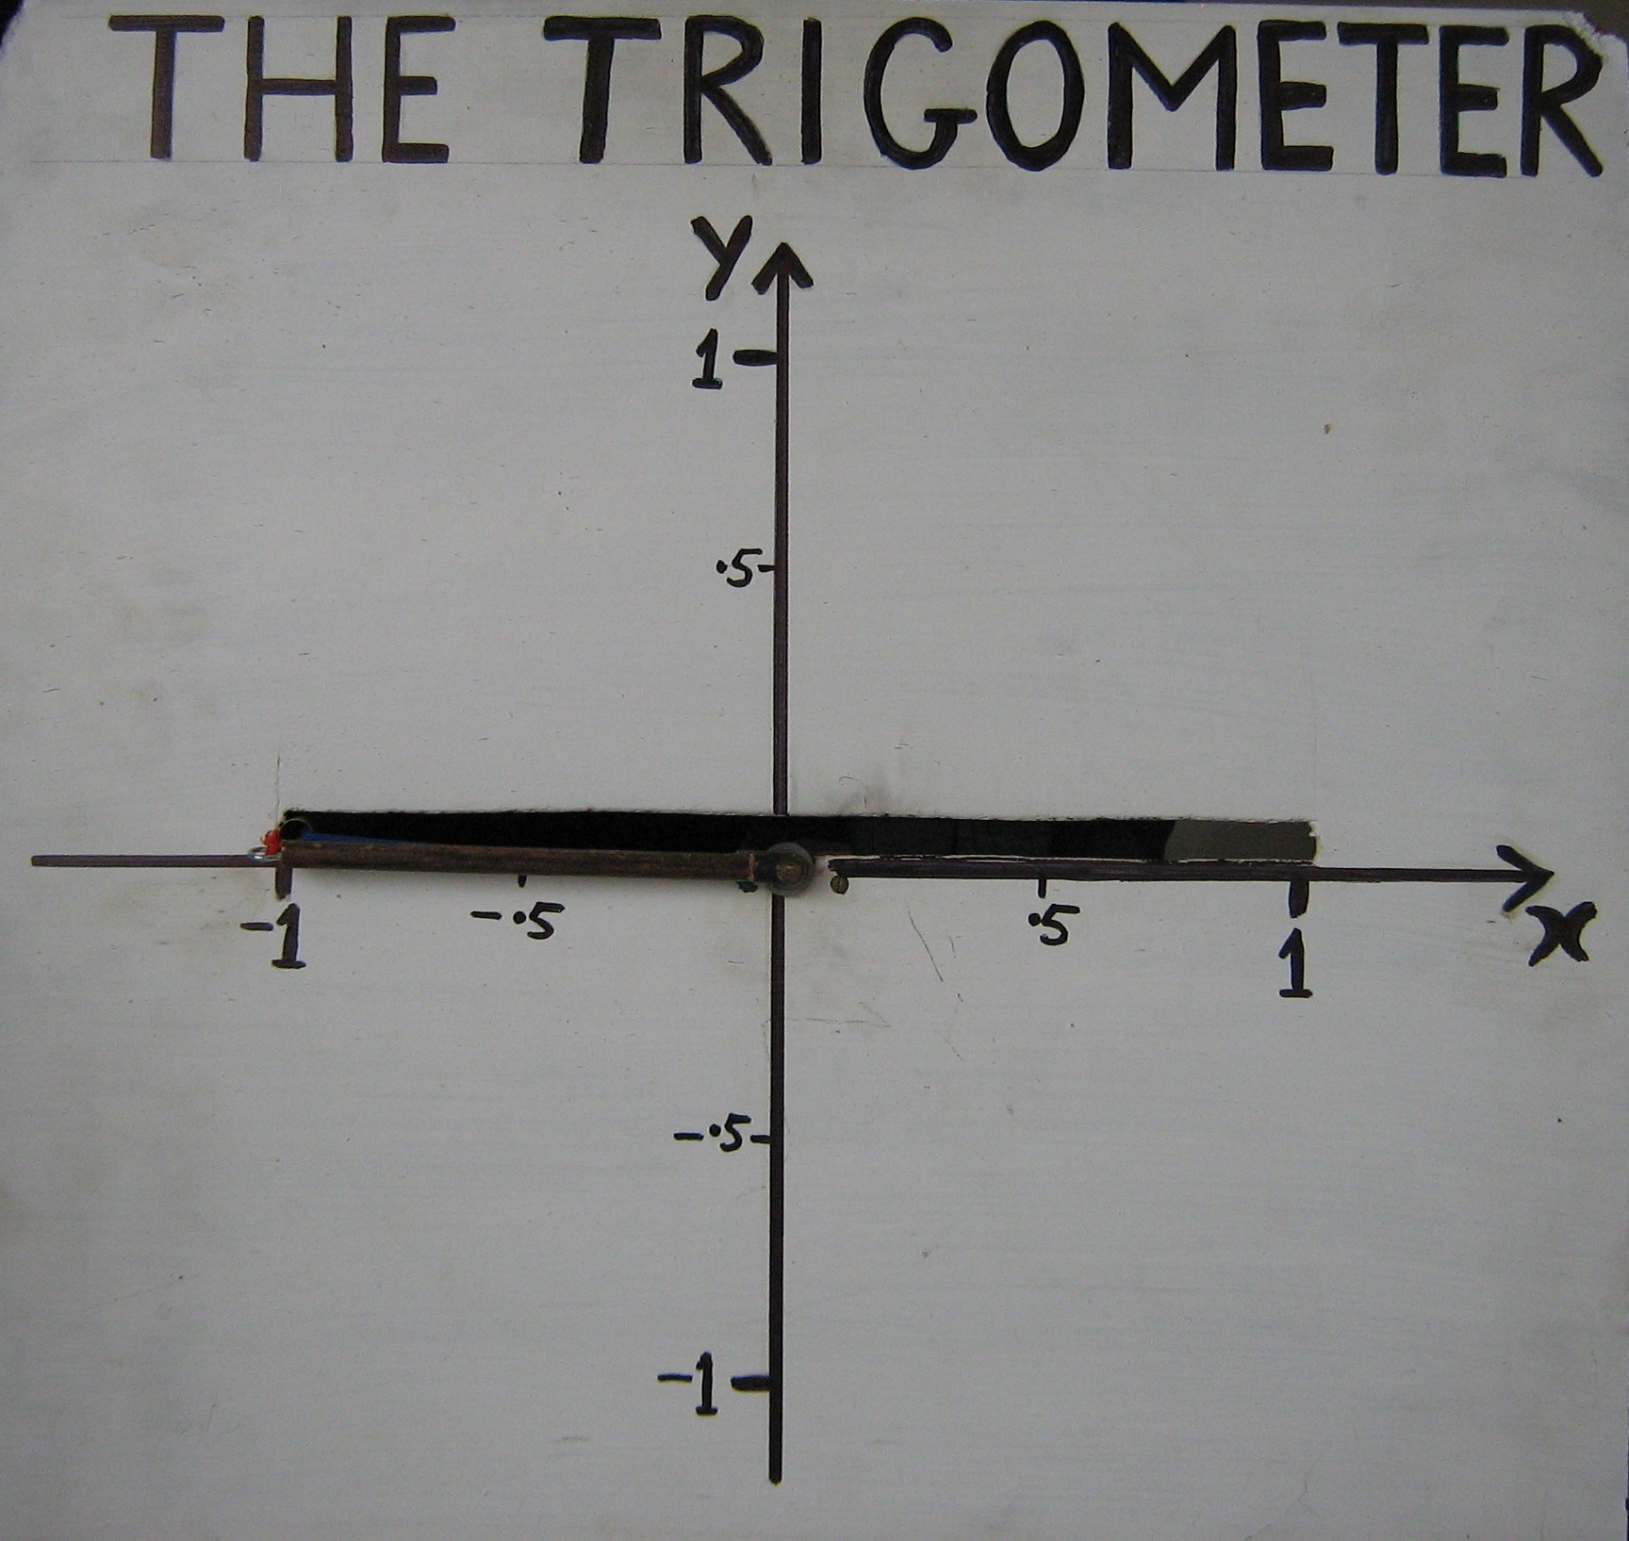
Angle θ has now increased to 180 degrees
Sin 180 = 0
and cos 180 = – 1

Slide 16
os
When θ is between 180 degrees and 270 degrees we see that
The y coord is negative so
sin θ is negative
The x coord is also negative so
cos θ is negative too.

Slide 18
Here the y coord is – 1
so sin 270 = – 1
And the x coord is zero
so cos 270 = 0

Slide 20
For angles between 270 degrees and 360 degrees we see that the
y coord is negative so sin θ is negative
But the x coord is positive again so
cos θ is positive again.

Slide 22
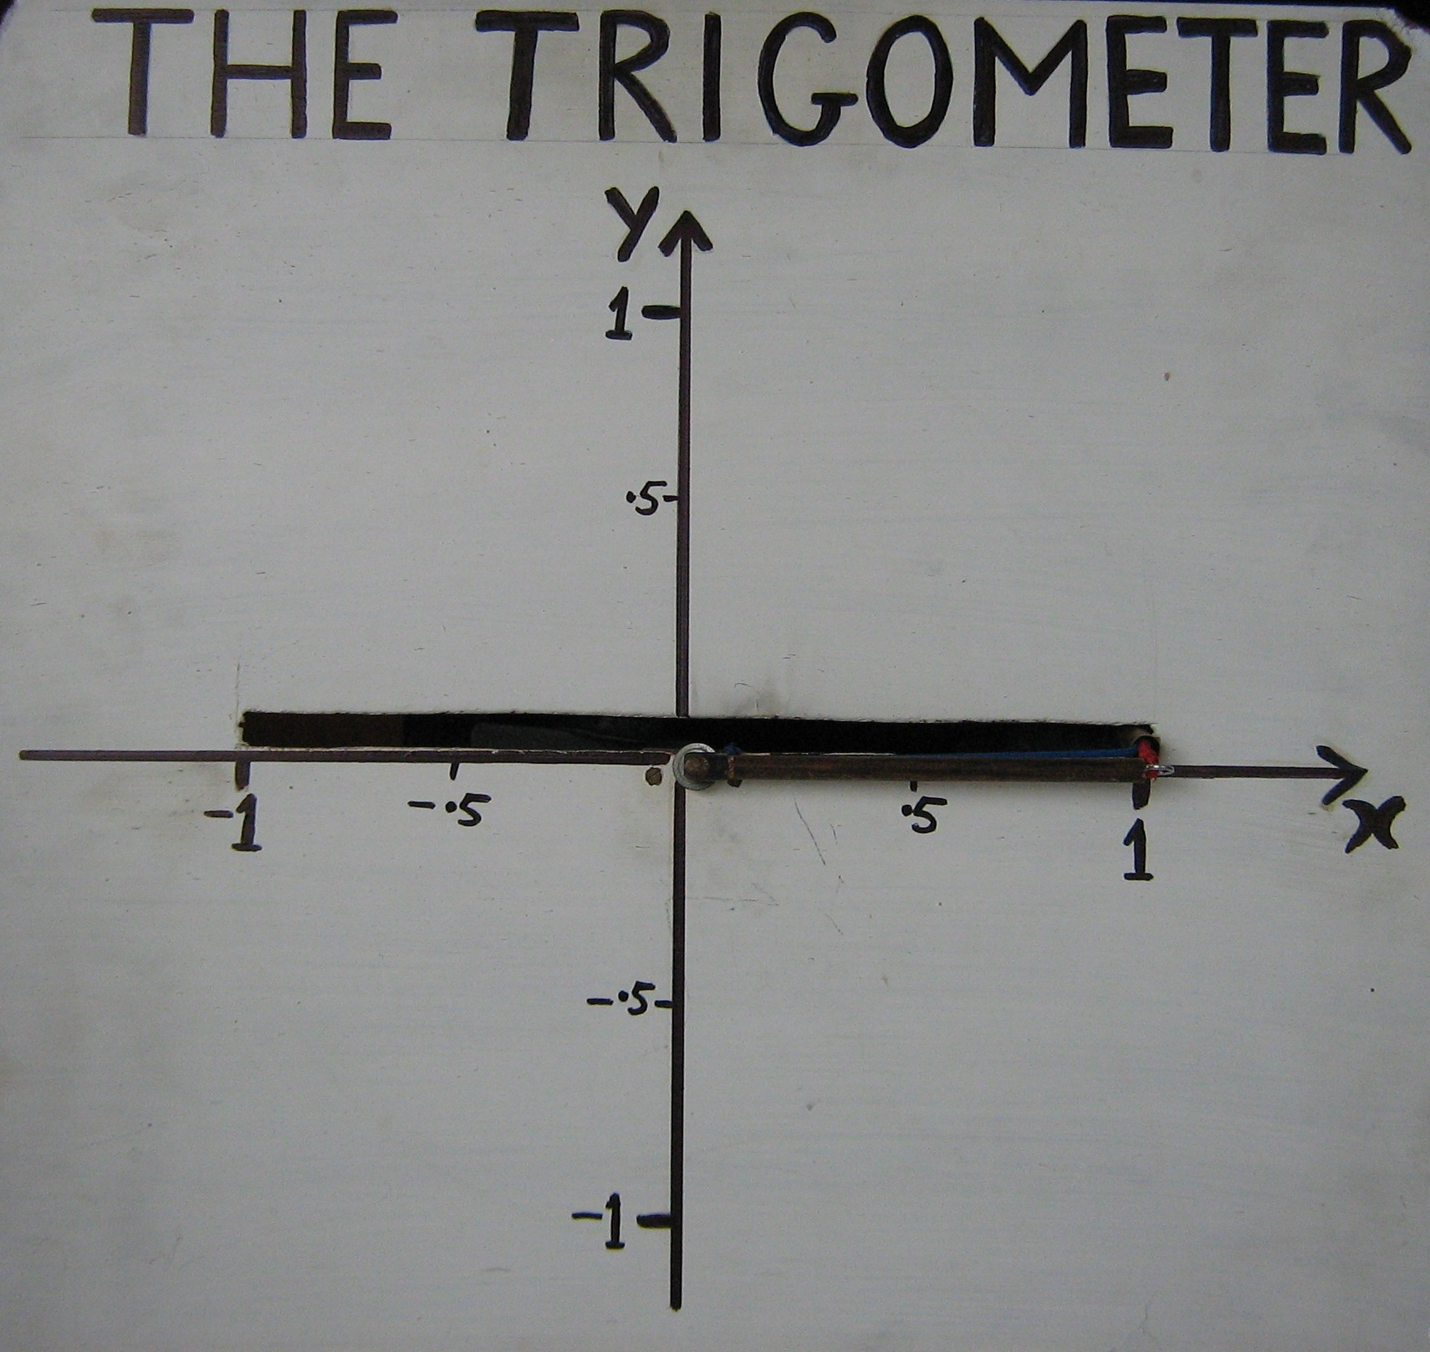
Angle θ is now 360 degrees which puts everything in the same position as for 0 degrees.
Sin 360 = 0
Cos 360 = 1

Slide 23
Angles such as – 330⁰ can be demonstrated very successfully too.

Slide 24
Sin( – 330) = + 0.5
Cos ( – 330 ) ≈ + 0 87
θ = – 330⁰

Slide 25
Angles greater than 360⁰ such as 390⁰ can be demonstrated very successfully too

Slide 26
Sin 390 = + 0.5
Cos 390 ≈ + 0.87
θ = 390⁰

Slide 27
When the above is UNDERSTOOD, it makes more sense where the sin and cos graphs are positive and where they are negative.
y y = sin x
x
y y = cos x
x

Slide 28
The identity sin² θ + cos² θ = 1 often turns up in calculus problems.
Whenever it does, I say
“Why does it equal 1?”
I expect my students to reply with the following explanation.
Then I KNOW they UNDERSTAND!

Slide 29
Obviously y = sin θ and x = cos θ
1
y
x
Also y² + x² = 1 (Pythagoras’ Theorem)
so sin²θ + cos²θ = 1
= sin θ
θ
= cosθ

Slide 30
END OF PART 2

