Slide 1
PART 1.

Slide 2
“UNDERSTANDING” v “USING RULES”
My personal guiding principle
or philosophy:
To Teach mathematics using REASONS not RULES.

Slide 3
There is a big difference between
“Knowing” a thing and
“Understanding” it.

Slide 4
What does 2⁰ equal?
Most students KNOW it is equal to 1.
NOBODY ever knows WHY it is 1.
They KNOW it but don’t UNDERSTAND why it is true.

Slide 5
This is basically how I proceed:
We know that b³ means b×b×b
and b² means b×b
and b¹ means b
but b⁰ does not seem to
make any sense!
and b ^{– 1} seems to make
even less sense!

Slide 6
Using what we DO know:
b³ × b² means b×b×b×b×b = b⁵
So we see that we do not need to write all the b’s out.
We could just generalise and put b¹⁷×b¹³ = b¹⁷ ⁺ ¹³ = b³⁰
and so b ^{n} × b ^{p} = b ^{(n + p)}

Slide 7
Similarly, b⁵ = b×b×b×b×b = b²
b³ b×b×b
We can generalise here too so that
b¹⁸ = b ^{18 – 14} = b ⁴
b¹⁴
and so b ^{n} = b ^{n – p}
b ^{p}
Now this SEEMS to be fine as long as n > p

Slide 8
Suppose we want b³
b³
If we use the “rule” above, we get an unusual answer b³ = b^{3 – 3} = b⁰ ?
b³
but if we use fundamental logic we get
b³ = b×b×b = 1
b³ b×b×b
The LOGICAL conclusion is that :
b⁰ MUST be 1

Slide 9
Similarly, suppose we want b³
b⁵
If we use the rule above, we get an unusual answer b³ = b^{3 – 5} = b ^{– 2} ?
b⁵
but if we work it out using the logic we get
b³ = b×b×b = 1
b⁵ b×b×b×b×b b²
The LOGICAL conclusion is that :
b ^{– 2} MUST be 1
b²

Slide 10
Now we have a meaning for “b” to the power of any INTEGER.
b³ means b×b×b
b² means b×b
b¹ means b
b⁰ means 1
b ^{– 1} means 1
b
b ^{– 2} means 1
b²
b ^{– 3} means 1
b³

Slide 11
Incidentally, if we know that b ^{n} × b ^{p} = b ^{(n + p)}
we can consider indices which are fractions.
Consider 9 ^{½} × 9 ^{½} = 9 ^{½ + ½} = 9¹
but 3 × 3 = 9
so 9 ^{½} must be √9 which is 3
Similarly 8 ^{⅓}×8 ^{⅓}×8 ^{⅓} = 8 ¹
but 2 × 2 × 2 = 8
so 8 ^{⅓} must be the cube root of 8
NOTE: for most students a NUMERICAL verification is far more meaningful
than a so called “rigorous” algebraic proof.

Slide 12
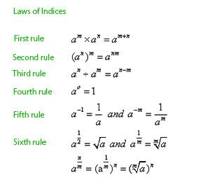
This is a typical type of poster on Indices:
It is just a list of RULES!

Slide 13
I would much prefer posters like these:
b³ = b^{3 – 3} = b⁰
b³
and b³ = b×b×b = 1
b³ b×b×b
so b⁰ MUST be 1

Slide 14
b³ = b^{3 – 5} = b ^{– 2} b⁵
and
b³ = b×b×b = 1 b⁵ b×b×b×b×b b ²
so b ^{– 2} MUST be 1
b ²
b^{½} × b ^{½} = b¹
and
√b × √b = b
so b^{½} must be √b
Posters like these are a constant reminder of WHY
things are true and not just a list of RULES.

Slide 15
Even when teachers spend considerable time introducing new concepts from first principles, many students just wait until a “RULE” appears then they happily proceed to apply the rule with no actual understanding whatsoever.
I think we need to re-visit these basic principles more often.

Slide 16
GOAL: to make mathematics more accessible to more students.
Many students get the idea that Senior Mathematics is only for the “top students”.
We need to show students that maths is just logic and not just a lot of rules.
This will raise their motivation and their self esteem which will improve their feelings of enjoyment and achievement.

Slide 17
KNOWING something is not the same as UNDERSTANDING it.
Suppose that young Jenny had been absent when the teacher taught “areas of triangles”.
The teacher quickly tells young Jenny that you just multiply the base and the height and then divide by 2.
Jenny instantly gets the idea and confidently uses:
Area = b × h
2
and manages to use this formula correctly for next 10 questions.
Jenny “knows” how to find the area of a triangle but she has no “understanding” of WHY the method works.

Slide 18
To illustrate this point further, suppose she were told that the area of a triangle is found by multiplying the base and the height then dividing by 3!
Area = b × h
3
Jenny would have cheerfully followed this formula and used it “correctly ” for the next 10 questions believing that she “understands” how to find the area of a triangle.
Actually, she only KNOWS how to follow an instruction. It is not based on UNDERSTANDING.
The fact that it produced wrong answers is irrelevant.

Slide 19
Here is a very similar problem…
How do you explain to younger students WHY the volume of a PYRAMID equal to:
Area of base × Height
3
i.e. why divided by 3?

Slide 20
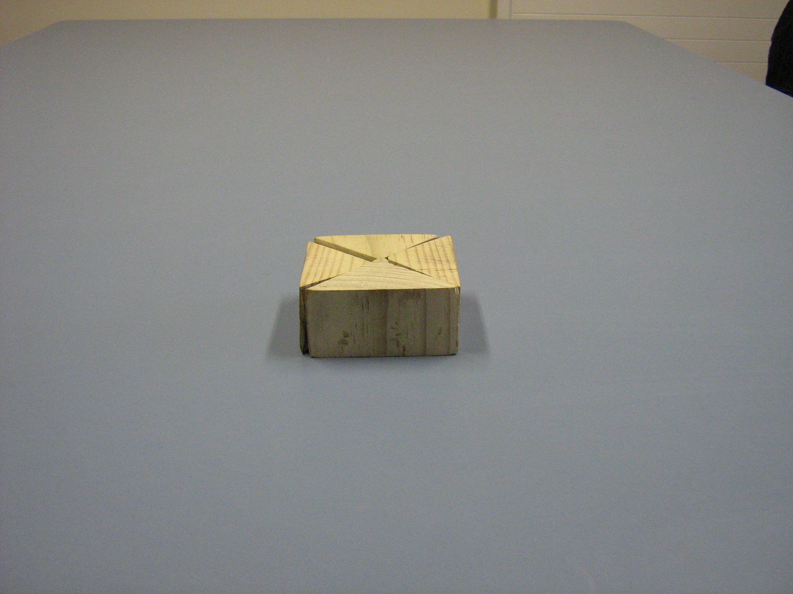
The volume of this CUBOID = Area of base × height or V = a b h
Rotate these two pieces 90 degrees

Slide 21
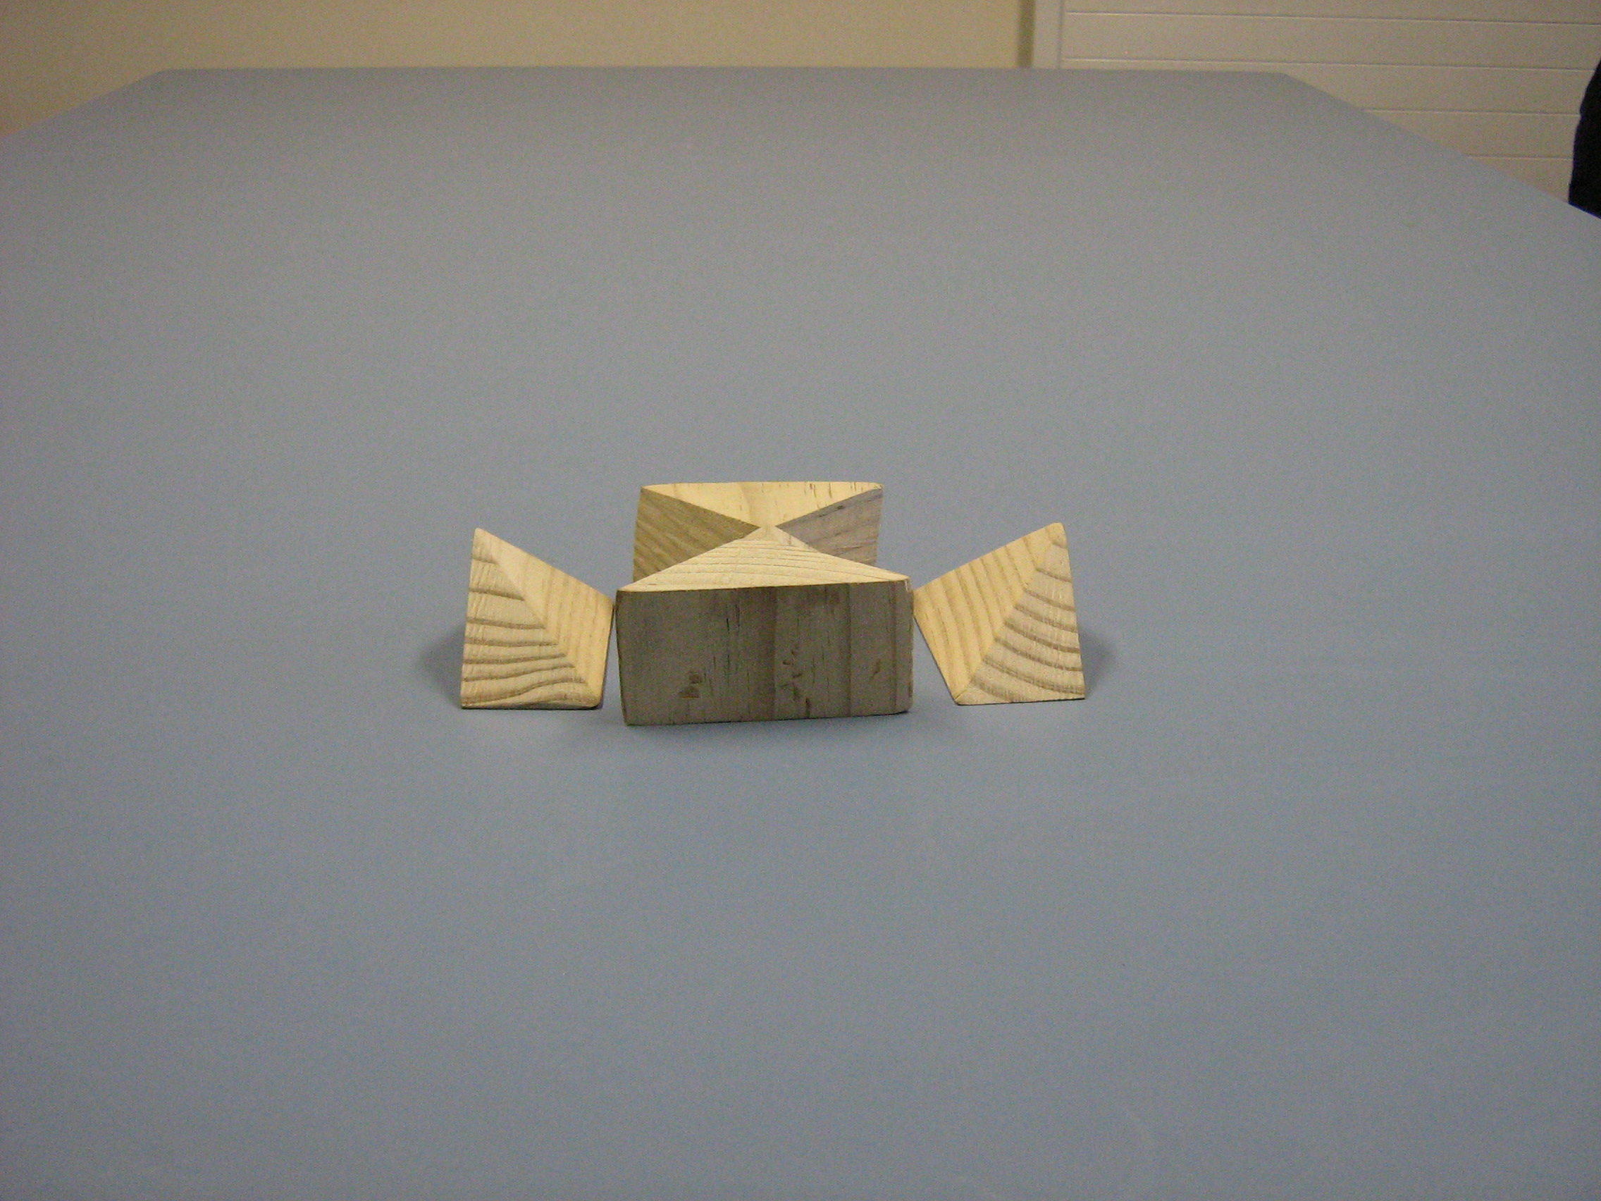
Now rotate this piece
and this piece

Slide 22
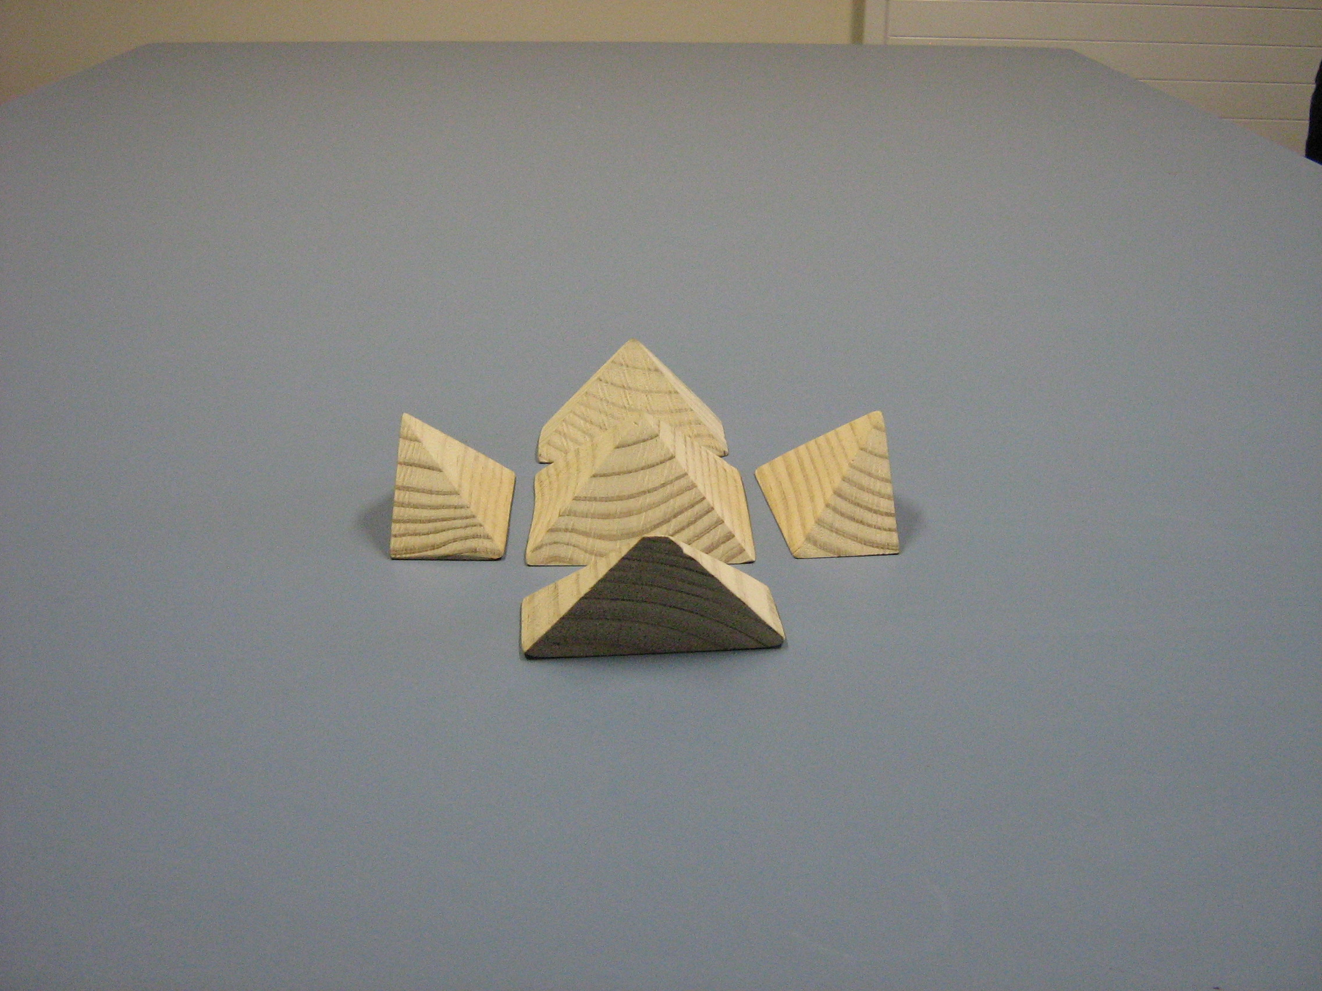
To here
Now move this piece

Slide 23
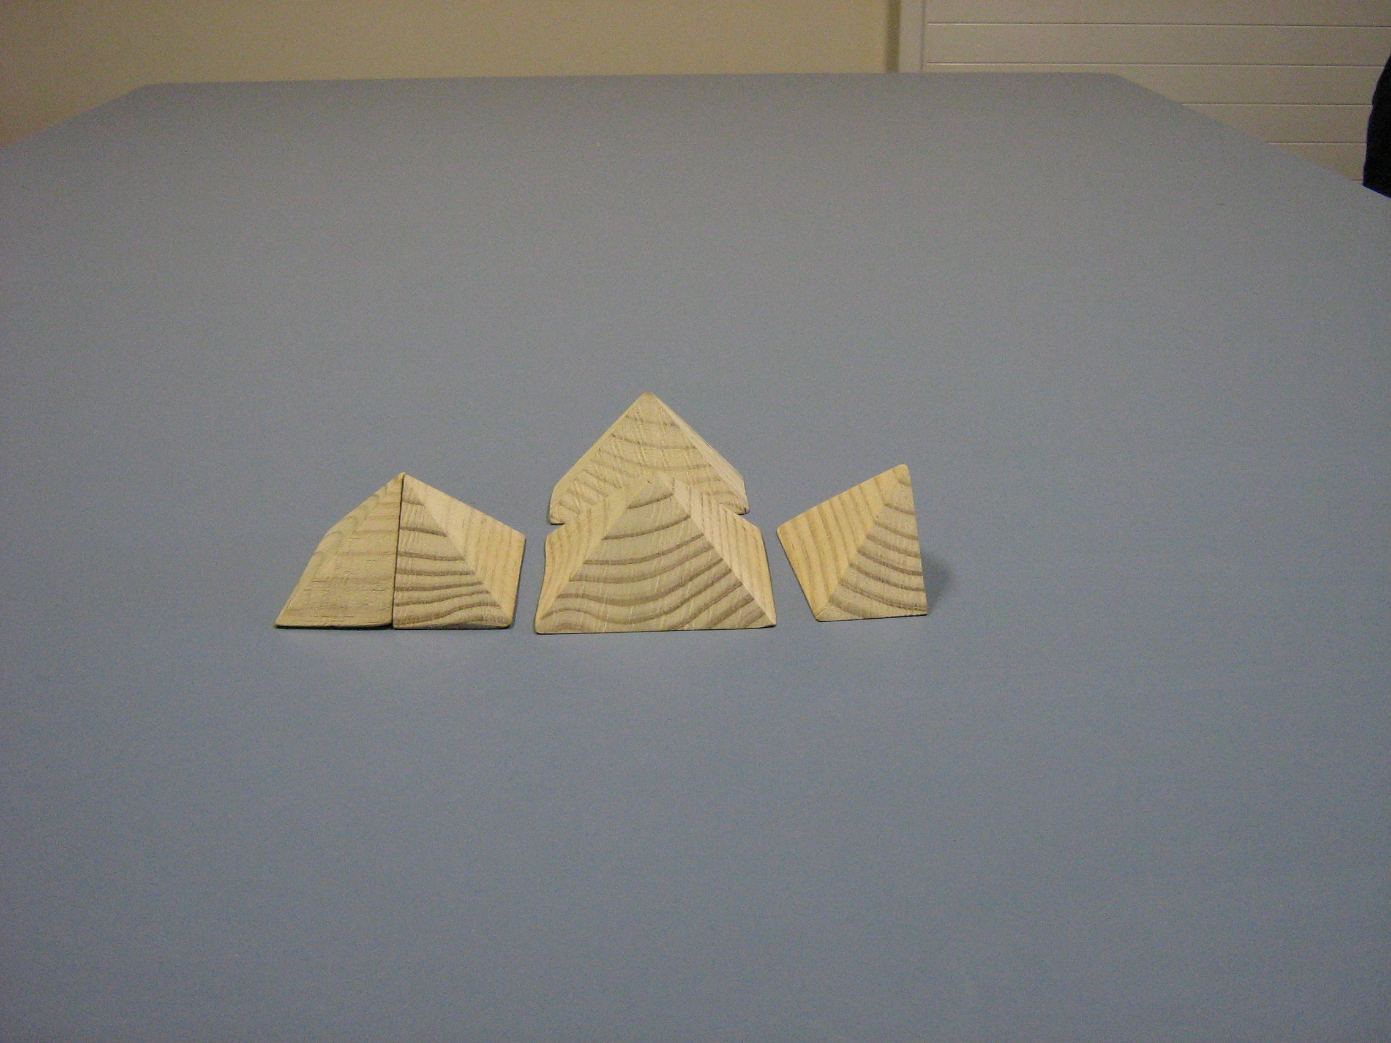
and this piece
to here

Slide 24
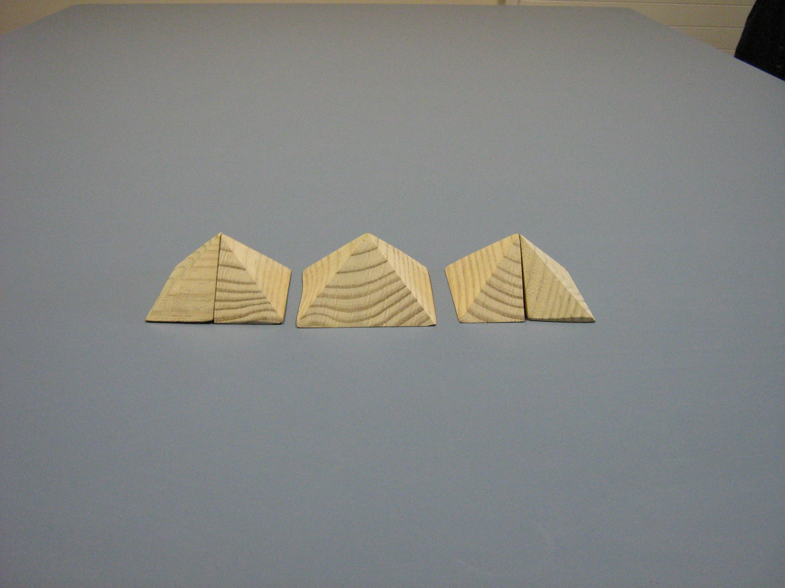
I have made 3 equally sized PYRAMIDS from the CUBOID
So the volume of a PYRAMID must be
V = Area of base × Height
3

Slide 25
Many people think maths is just a set of rules and if you know the rules you are good at maths.
I tell my students that mathematicians do often have to make rules and formulas for people who don’t understand how to do it themselves!
But “WE” are going to learn WHY things are true so that we understand maths!

Slide 26
Whenever we need to use things like:
b⁰ =
sin²x + cos²x =
log (x) + log (y) =
cos 180⁰ =
I always say, “Who remembers WHY?”
1
1
log(xy)
– 1

Slide 27
Years ago, I decided I needed to re-vamp the standard mathematical “academese” that you find in text books so that 16 and 17 year old students could follow it far more easily in simpler language they can understand!
I realised that the texts never addressed the “tricky” questions that students needed to understand.

Slide 28
(a) Why does the chain rule work?
(b) Why is “integration” the opposite
of “differentiation” ?
(c) Why does the dx in integrals
appear to mean nothing until you
have to do a substitution and how
does that work anyway?

Slide 29
(d) How does √(-1) really exist?
(e) What does 0 equal?
0
(f) If y = 2^{x} why don’t we get dy = x×2^{x – 1} ?
dx
(g) If x² + y² = 4 how do we get 2x + 2y dy = 0 ?
dx
(h) Do we EVER need radians for anything other
than differentiating trig functions?
ANSWER: NO!

Slide 30
If y = x⁷ then WHY is dy = 7x⁶ ?
dx
(I don’t want my students to just accept a rule!)
If sin(θ) = the length of the opposite side
the length of the hypotenuse side
then how can sin(θ) be NEGATIVE?

Slide 31
END OF PART 1

